Slide 1
CLOUD COMPUTING
IV BTech - I SEMESTER JNTUH
By
Dr. P.SAMMULAL

Slide 2
UNIT-1

Slide 3
Scientific applications – Problems
[Grand Challenge Applications]
1.High energy physics
2.Bioinformatics
3.Remote sensing
4.Pattern matching
5.Weather forecasting etc.,
Solution is High Performance Computing
Memory management technique
Proper Scheduling mechanism
Load balancing mechanism

Slide 4
Different schemes of computing
Parallel computing:
A Computer with two or more CPU running a parallel program. So independent modules in the program can be run by each CPU simultaneously.
Distributed Computing:
Two or more computers in a Network execute independent modules of a single job.
Grid computing:
It is similar to Distributed Computing, computing units can span geographically different locations (WAN). Computing units in different organizations.
Cluster Computing:
It is for failover. Multiple units work in a cluster. All are doing the same job. If one unit fails the other one become active. Or can be load balanced across the cluster.
Cloud Computing:
Is a standardized IT capability (Services, Software, or Infrastructure) delivered via internet technologies in a pay-per-use, self-service way.

Slide 5
High Performance Computing
This is not a technology, but it tells you the ways of generating more computing power.
To generate computational power, couple the set of processors (CPUs) using tightly or loosely coupled systems and make them to work as a one unit using a software, so that more computational power is generated.
The systems / processors connected (coupled) may be Homogeneous type (having similar architecture) or Heterogeneous type (having different architecture).
The technology used for generating more computational power by using set of CPUs / Processors may be through clusters, grids, clouds etc

Slide 6
Parallel Computing
A parallel computing system is a collection of set of Homogeneous Processors (CPUs) tightly coupled together to perform a computational task.
Tightly coupling means, the processors are placed closer to each other, normally side by side on the same motherboard and connected by a high speed external buses.
In parallel computing, all processors work simultaneously on different task to solve a problem. These systems are also popular as Multiple Instructions Multiple Data Stream (MIMD) computers meaning that executes multiple instructions at a time and works with multiple data items.
In parallel computing systems, the given problem is divided into a discrete independent problems. Each problem is converted into a series of instructions to be executed. Each processor works on a subproblem to get the solutions (results).

Slide 7
when results are obtained from all processor, they are combined to form a final result.
Thus, system works at high speeds by dividing a problem into many independent sub problems, each sub problem is executed simultaneously on one processor hence, problem is solved in a short span of time.
In a conventional computer (PC), the given problem is directly converted into a large no. of sequential instructions to be executed, these instructions are executed on only one CPU one after the other. Hence, it will take more time to get the final result.

Slide 8
Distributed Computing
It is a set of computing machines or processors connected over a small network like LAN, MAN.
The system may contain processors of heterogeneous type (CPUs with different architecture).
The CPUs are loosely coupled means that the CPUs are not closer to each other, they may be at a small distance apart and connected over a LAN or they may be spread over little distance apart and connected over a MAN.
A software running on all systems provide coordination among CPUs to work as a single unit system to solve the problem.

Slide 9
Distributed Computing
Distributed computing systems are popular because of 2 – following reasons.
Scaling
Redundancy
Scaling means, the computational power in the distributed system can be increased by adding more no. of systems on to the network (scale-up) or can be decreased by removing few systems from the network (scale-down) as and when required.
Since, the distributed computing system supports heterogeneous processors, there may be processors/machines of same type offering same type of services to the user.

Slide 10
Distributed Computing
Thus, if a system/machine is going down, the same type of service may be available by another system. Thus, service interruption is not experienced by the users. All these are possible because of the replication of systems of same type (also called as redundancy).

Slide 11
Grid Computing
Most of the organizations contains lot of IT infrastructures like computers, storage, software, applications, network devices that may be under utilized by the organization such as a underutilized computer power can be given to needy organizations to solve their computational power problem on a rental or hiring basis. This will make the organization to get some revenue on their IT infrastructure.
A grid computing is a technology that connects all the underutilized computing resources over a wide area network and makes them to work as a unit to solve the problems.
In a grid computing, different types of systems are connected from different geographical areas over a network and works together.

Slide 12
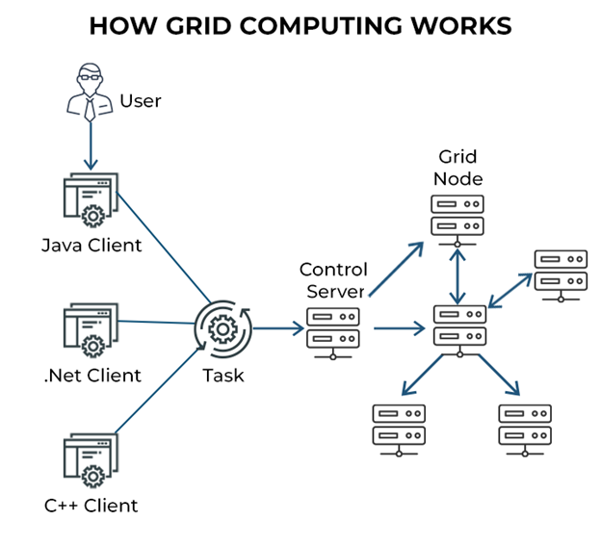

Slide 13
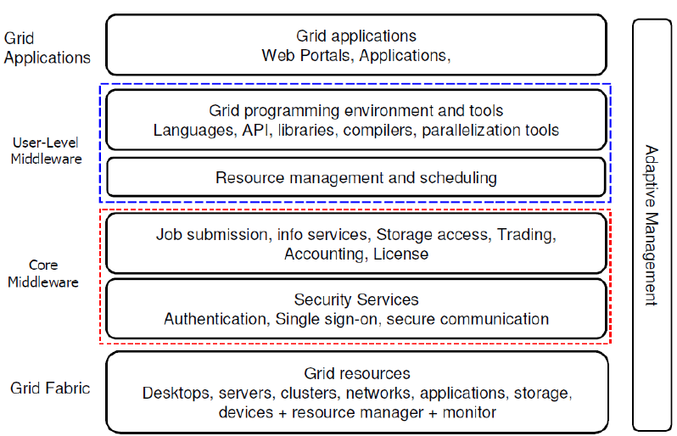

Slide 14
Grid Computing
In a Grid, a software running on computers make them to work together and make them to be accessible over a network. This software is called “Grid Middleware”.
Grid service provides different kinds of services to the users such as access control, security, access to the data bases, digital libraries, data storage systems etc.
In a grid, computing resources are allocated to the users as per their computing requirement but, these resources cannot be dynamically provisioned to the users when they are running applications. All the required resources must be acquired well in advance before starting the application.

Slide 15
Grid Computing
Grid Computing can be visualized like a Power Grid. Both have many similarities except that power grid is used to distribute electrical power to the houses in villages, towns, cities etc where as computer grid is used to distribute computer/computing power to the organizations whom they need.
Some of the similarities between power grid and computer grid.

Slide 16
Advantages of Computing Grid:
Computing grid makes uses of heterogeneous computers as a part of its infrastructure so every resource is utilized up to full extent.
Computing grid uses any computing resource available anywhere across the globe so more no. of resources can be collected from different places.
Computing grid provides computational power to the needy organizations based on their requirement, this adds to the computation power increase of organization.

Slide 17
Cluster Computing
Complex tasks can’t be performed using a
individual machine
Alternative is, use a group of computers to
work on a problem

Slide 18
Cluster Computing
Definition:
Cluster computing has emerged as a result of the increasing availability of powerful but inexpensive computers and high performance networks as commodity components.
This has been further facilitated by the fusion or unification of the fields of parallel high performance, distributed, high availability computing and internet technologies.

Slide 19
Definition of Cluster
It is a collections of tightly coupled computer systems connected over a high speed network(LAN)

Slide 20
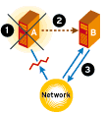
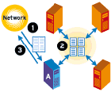
Major types of Clusters:
High Availability Cluster High Performance Cluster

Slide 21
Cluster Computer Architecture
Parallel Applications
Sequential Applications
Parallel Applications
Sequential Applications
Parallel Applications
Sequential Applications
Parallel Programming Environment
Cluster Middleware
(Single System Image and Availability Infrastructure)
PC/Workstation
PC/Workstation
PC/Workstation
PC/Workstation
Communications
Software
Communications
Software
Communications
Software
Communications
Software
Network Interface Hardware
Network Interface Hardware
Network Interface Hardware
Network Interface Hardware
Cluster Interconnection Network/Switch

Slide 22
High Speed Interconnection N/w
Myrinet: is limited to 16 nodes connected by either 8-m or 25-m cable. Theoretical peek bandwidth is 1.28 Gb/s in 8-m cables, 550Mb/s in 25-m cables.
Memory Channel :connects a maximum of 10 to 20 nodes, with 800 Mb/s bandwidth and raw 5 μs hardware latency
Infini band, Fastest Gigabit Ethernet etc.

Slide 23
Cluster Computing
All nodes in the cluster run its own OS
Usually all nodes run same OS
Used for improving
Processing speed
High performance
Availability

Slide 24
Cluster Computing
Nodes in cluster are administered (managed) by a central computer called Master
All other computers are called Slaves
Master controls the operations of nodes
Master assigns tasks to nodes
Master runs Clustering Middleware

Slide 25
Cluster Computing
Middleware is a software that
provides cluster as a single computing unit
allows users to interact with cluster
All nodes in cluster work on same problem

Slide 26
Cluster Computing
Advantages
Low cost
High Performance
Elasticity
Reliability
Runs tasks anytime, anywhere
Security

Slide 27
Cluster Computing
Important Points about clusters
All nodes are in same LAN
All nodes are closer to each other
All nodes run similar OS
All nodes work together on same task
All nodes controlled by Master
Nodes may be tightly/loosely coupled

Slide 28
Cluster Computing
Important Points about clusters
Provides load balance for High
Performance
Provides reliability
Highly Available (HA Clusters)
Has Linux-HA Project

Slide 29
Multi Cluster Architecture
A multi-cluster architecture consists in interconnecting two or more clusters to configure a new parallel machine.
On occasions, combination of interconnected homogeneous clusters, is used.

Slide 30
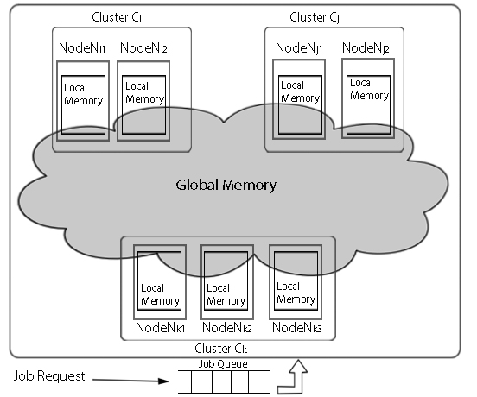

Slide 31
Cluster Computing vs. Grid Computing
Cluster Computing Characteristics
Tightly coupled computers.
Single system image.
Centralized job management and scheduling system.
Cluster computing is used for high performance computing and high availability computing.
Grid Computing Characteristics
Loosely coupled computers.
Distributed JM & scheduling.
No SSI. It is the superset of distributive computing. It's both used for high throughput computing as well as high performance computing.

Slide 32
Major issues in Cluster design
Enhanced Performance (performance @ low cost)
Enhanced Availability (failure management)
Single System Image (look-and-feel of one system)
Size Scalability (physical & application)
Fast Communication (networks & protocols)
Load Balancing (CPU, Net, Memory, Disk)
Security and Encryption (clusters of clusters)
Distributed Environment (Social issues)
Manageability (admin. And control)
Programmability (simple API if required)
Applicability (Cluster-aware and non-aware app.)

Slide 33
Possible ways of Improving Performance of a cluster
Processor:
Already achieved to the peak due to the heat produced in the manufacture.
Network:
Various efficient high speed Network technologies available in the market.
( Myrinet, InfiniBand..etc.,)
Memory:
Using various schemes for memory management.

Slide 34
Memory management bottleneck in cluster
Gap between processor and memory speed.
High bandwidth and efficient network.

Slide 35
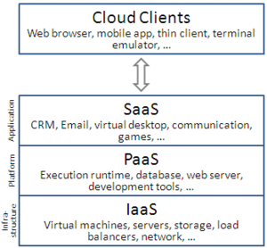
Cloud Computing
Cloud computing is a computing infrastructure and software model for enabling ubiquitous access to shared pools of configurable resources (e.g., computer networks, servers, storage, applications and services), which can be rapidly provisioned with minimal management effort, often over the Internet.
Cloud computing allows users, and enterprises, with various computing capabilities to store and process data in either a privately owned cloud, or on a third-party server located in a data center in order to make data accessing mechanisms more efficient and reliable. Cloud computing relies on sharing of resources to achieve coherence and economy of scale, similar to a utility.

Slide 36
Mobile Computing
Mobile Computing is a technology which allows the transmission of data, voice and video from one device to another device without having any connection.
A mobile is a small hand held device with a small processor embedded in it. These devices are used to perform computations for supporting voice, data and video transmissions.
Mobile computing technology has been developed enormously over the last 10 years. Supporting data transmission, audio conferences and video calling over multiple networks.
The early mobile computing devices are called first generation mobiles have supported only voice transmissions over telephone connections.

Slide 37
Mobile Computing
The 2nd generation mobiles have supported SMS and small speed data services.
The 3rd generation mobile have given support for audio, SMS, high speed data services, MMS etc.
The 4th generation mobile also supported audio conference facility and video calling facility with high speed data transmission.
The network technologies are also parallelly developing with the advancements in the technologies to support high speed data transmission over the internet.

Slide 38
Mobile Computing
Every mobile device establishes a network with the other near by devices using wireless networking capabilities such as Bluetooth, WiFi, Hotspot etc.
Today, mobile computing technology has been developed to its full potential by embedding more powerful processors in mobile.
Today, because of powerful processors in mobiles, it is possible to connect them to the internet and gain access to the different information sources as and when required.

Slide 39
Bio Computing
Bio Computing is a technology where a biologically simulated or derived molecules are used to perform computations as a part of applications. The biological structures of the molecules provides a way to develop programming models/structures to perform a computations.
The bio computing technology provides a theoretical background and practical tools to the bio-scientists to study and analyze the structure of protein and DNA.
The proteins and DNA are the basic building blocks for constructing the molecules of biological objects/things.

Slide 40
Bio Computing
The order of DNA and protein in the molecule give a final shape to the molecules. Different molecules of different objects contain different structures. These structure are used in the programs to develop applications to solve the problems.
The realization of aero plane is the study of biological structure of birds, the robot is the study of biological structure of a human being etc.
The bio computing technology is booming like any thing nowadays. The structure of different biological things under analysis phase, once they are realized different technological objects can be constructed in the future.

Slide 41
Quantum Computing
A Quantum is a unit of energy. The energy is transmitted in the spaces in amounts of quantum.
The quantum moves at the speed of light which is much faster than the speed of an electron.
The computer which is developed using the fundamentals of quantum theory are called quantum computers.

Slide 42
Quantum Computing
Quantum computers mainly depends on theory of quantum physics. Their working principles are completely different than electronic computer principles.
Quantum computers are much faster i. e millions of times faster than electronic computer.
Quantum computers are not realized even today, there exist some working models, it is in still experimental stages.

Slide 43
Optical Computing
Optical computing technology uses photons in visible or infrared light.
The light energy is transmitted in the space in the form of photons. Photons carry the energy and moves at the speed of light which is 10 times faster than the speed of electron.
The limit of keeping a greater number of transistors on a silicon chip can be overcome by using photons.

Slide 44
Optical Computing
Photons can travel longer distances without loosing their energy as they use fiber optical line to travel longer distances.
The fiber optical lines are now replacing all the existing copper lines for faster data transmission. The networking technologies are also making use of fiber optical devices and components replacing the electronic devices and components at the possible places to improve data transmission rates.

Slide 45
Nano Computing
Nano Computing technology was nano scale components to develop electronic chips using nano carbon tubes.
The electronic chip manufacturers complain that there is a limit on keeping number of transistors on chip limiting the computational power. This can be overcome by using nano carbon tubes where more number of transistors can be accommodated and there by possibility is there to increase computational power enormously.

Slide 46
The development of chips using nano carbon materials have limitations as per as manufacturing is concerned:
Developing different blue prints/models for chips are expensive and most of the manufacturers do not accept it.
The nano carbon chips if at all if they are used, a number of other components are to be developed for supporting these chips which adds additional cost.
The nano technology has not yet been developed to its full strength still it is under experimental stage.
Any component that is designed in the size of 1 – 100 nm range is called a nano component.

Slide 47
Network Computing
The networking computing is not a computing technology on its own but it provides a way to the computers/processing elements to be connected over the network by making use of advancements in the network technology.
All the technologies like cluster, cloud, grid, mobile computing technologies comes under network technologies. These technologies generate more computing power.
Normally, in the network-based computing technologies, the network architecture contains two parts:
Client Architecture Portion
Server Architecture Portion

Slide 48
Network Computing
The client portion of the network architecture is designed to run at the user/client side that provides a facility to the user to make use of the application with minimal effort and easy to use tools.
The client portion is normally having a GUI INTERFACE that facilitates the user to easily interact with the application and to perform their task easily.
The server portion of the architecture is running at server side and may provide services to the client portion.

Slide 49
The server portion will be running on the server and makes all the application services are made available to the client portion with a minimal effort and interface.
The client portion of the architecture will support the functions of the user at low cost and easy to use interface.
This type of network-based computing solution provides computing resources to the businesses to maximize their computing power and brings a +ve impacts on the business and provides the facility to the Business organization to serve their customers easily using strong underlying network of computing resources.

